Slide 1
RGB-D Object Detection
Members Name: Divine Bakala
Abdul Muizz
Osazuwa Osarumen

Slide 2
The Objectives
To do objects detections on Vineyard RGB-D datasets.
To identify the grapes in the RGB-D images.
To do transfer learning/pretrained models as our model.

Slide 3
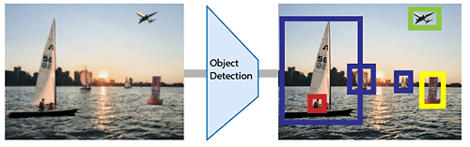
Object detection
Finding object by giving the image.

Slide 4
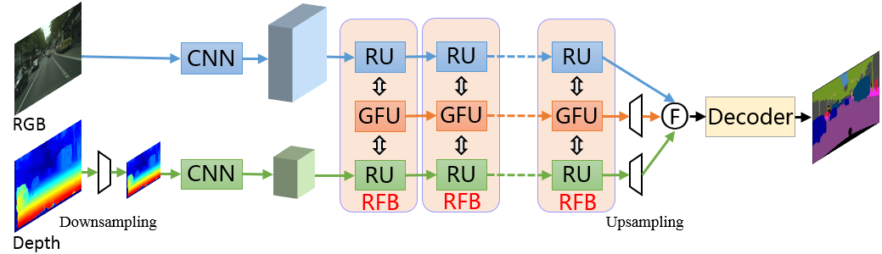
Choosing Model (Sensor Fusion)
RFBNet
RGB-D images into an image.

Slide 5
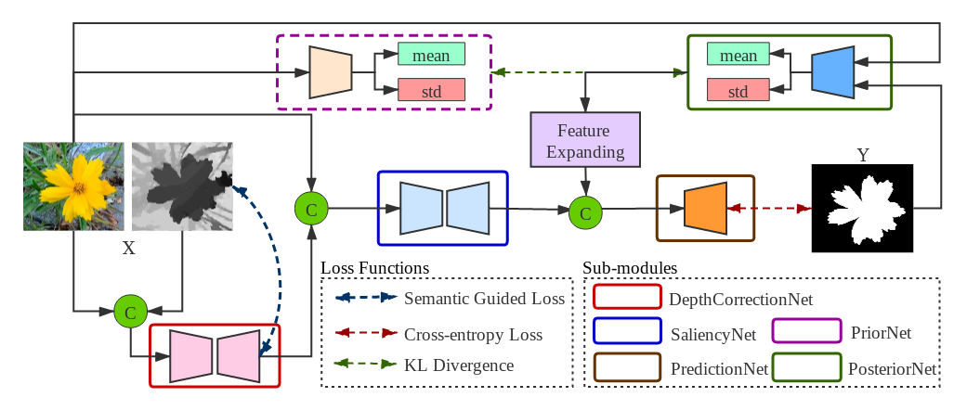
Saliency Object Detection

Slide 6
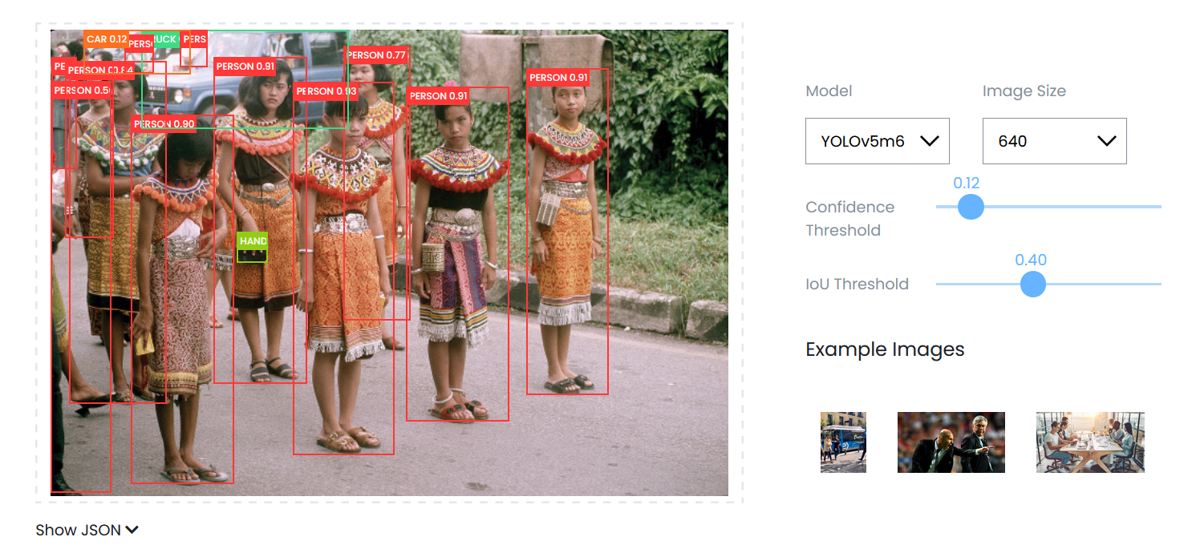
Object Detection
YOLOv5

Slide 7
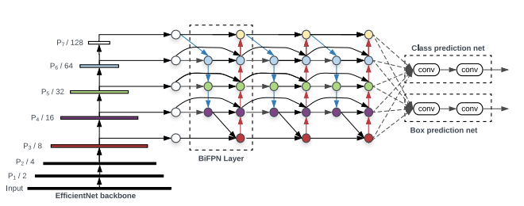
Yolov5

Slide 8
Progress/Planned
Reading
Sensor Fusion
Object Detection
Pretrained model
Testing pretrained model
RFBNet
YOLOv5
Testing
Datasets
Data collection
Implementation
Not yet decide
Data pre-processing
Data Transformation
Training
Not yet decide
Not yet decide

